Slide 1

krishak
TODAY’S DATE
11-08-2025
– AGENCY NAME CAPITAL ONE
– TEAM NAME
SHAFT

Slide 2
Team
1
2
HARIKA
TRUSHITHA
3
4
SHAFIYA
FLARANCE

Slide 3
Our PURPOSE
Agency Name x Partner Name
Phase X
MOTTO:
HELPING FARMERS DECIDE WHAT TO GROW BASED ON CLIMATE, SOIL, AND MARKET DEMAND, WHILE ALSO AIDING IN RESOURCE PLANNING LIKE WATER, FERTILIZER, AND POWER.

Slide 4


what we do
Language selection,Home page
Crop calender, Climate monitoring
Soil management, Market access
Power display

Slide 5
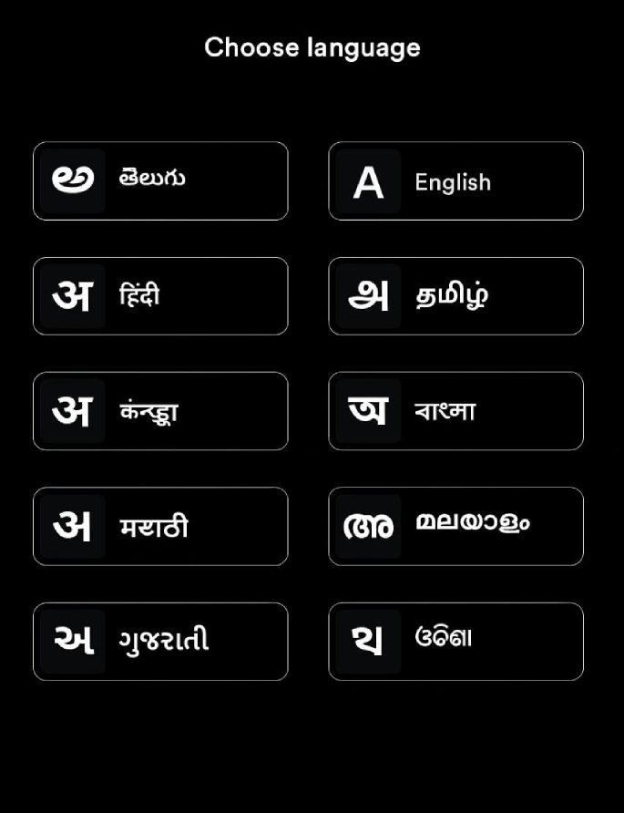

Slide 6











Market News & Offers
Welcome to Krishak
New
Your all-in-one solution for smart farming. Explore our tools to make informed decisions about your crops and resources.
Latest Market Trends
Search
Voice Assistant
Crop Calendar
Climate
Soil
Stay updated with the latest market trends and price fluctuations for various crops.
Market
Search for crops, regions, or market trends
Offer
Featured Crops
Discount on Seeds
Get 20% off on high-quality seeds for your next planting season. Limited time offer!
Crop Profitability
Most Profitable Crops
Wheat
Rice
Cotton
Sugarcane
High yield potential in suitable climates
Staple food crop with consistent demand
Cash crop with significant market value
Important crop for sugar production
Discover the most profitable crops to grow in your region based on current market demand.
Market Insights
Shops & Services
Market Trends for the Next Quarter
Get a detailed analysis of market trends, price forecasts, and demand patterns for various crops in the upcoming quarter.
Local Suppliers
Find trusted suppliers for seeds, fertilizers, and other essential farming supplies in your area.
Equipment Rentals
Rent farming equipment like tractors and harvesters at affordable rates from local providers.
Resource Planning
Optimize Your Resource Usage
Plan your resources efficiently, including water, fertilizers, and labor, to maximize productivity and minimize costs.
Regional Training
Upcoming Workshops
Attend workshops on sustainable farming practices, crop management, and new agricultural technologies.

Slide 7

Krishak
Dashboard
Crops
Market
Resources
Community
Search
Crop Calendar
Plan your farming activities for the year
January 2024
February 2024
S
M
T
W
T
F
S
S
M
T
W
T
F
S
1
2
3
4
5
6
7
1
2
3
4
5
6
7
8
9
10
11
12
13
14
8
9
10
11
12
13
14
15
16
17
18
19
20
21
15
16
17
18
19
20
21
22
23
24
25
26
27
28
22
23
24
25
26
27
28
29
30
29
30
Today's Actions
Irrigate the wheat field
8:00 AM
Fertilize the corn crop
10:00 AM
Check harvest readiness of the rice paddy
2:00 PM

Slide 8







Krishak
Climate Monitoring
Dashboard
Crop Advisor
Search for a location
Climate Monitoring
Current Weather
Resource Planning
Market Insights
Temperature
Humidity
Wind Speed
28°C
65%
15 km/h
7-Day Forecast
Date
Weather
High
Low
Precipitation
Today
30°C
20°C
0%
Tomorrow
28°C
18°C
10%
Day 3
25°C
15°C
60%
Day 4
26°C
16°C
20%
Day 5
29°C
19°C
5%
Day 6
27°C
17°C
15%
Day 7
30°C
20°C
0%
Weather Alerts
Heavy Rainfall Expected
A heavy rainfall warning has been issued for your area. Take necessary precautions to protect your crops.
View Details
Settings

Slide 9



Krishak
Soil Management
Dashboard
Soil Health Assessment
Crop Selection
Soil Type
Soil Management
Select Soil Type
Resource Planning
Market Analysis
Soil pH
Enter Soil pH
Soil Moisture
Enter Soil Moisture
Soil Temperature
Enter Soil Temperature
Assess Soil Health
Soil Improvement Suggestions
Based on your soil assessment, we recommend the following actions to improve soil health:
Add organic matter (compost, manure)
Adjust soil pH with lime or sulfur
Improve drainage with tiling or raised beds
Suitable Crops
Given your soil conditions and climate, these crops are well-suited for your land:
Rice
Wheat
Corn
Soil Fertility Enhancement
Enhance your soil fertility using these methods:
Organic Methods
Chemical Methods
Integrated Approach
Settings
Organic methods include using compost, green manure, and crop rotation to improve soil structure and nutrient content.

Slide 10

Krishak
Dashboard
Crop Planning
Resource Management
Market & Shop Access
Community
Market & Shop Access
Connect with local and online markets, access real-time crop demand and pricing data, and interact with potential buyers and sellers.
Market Opportunities
Search for crops or markets
Crop
Market
Demand
Price
Action
Wheat
Local Market A
High
₹20/kg
View Details
Rice
Online Market B
Medium
₹25/kg
View Details
Corn
Local Market C
Low
₹15/kg
View Details
Soybeans
Online Market D
High
₹30/kg
View Details
Cotton
Local Market E
Medium
₹40/kg
View Details
Shopkeepers
Search for shopkeepers or products
Shopkeeper
Location
Products
Contact
Shopkeeper 1
Village X
Seeds, Fertilizers
Contact
Shopkeeper 2
Town Y
Pesticides, Tools
Contact
Shopkeeper 3
Village Z
Irrigation Equipment
Contact
Shopkeeper 4
Town A
Organic Products
Contact
Shopkeeper 5
Village B
Livestock Supplies
Contact

Slide 11

Krishak
Dashboard
Crops
Market
Resources
Community
Power Information Display
Stay informed about electricity availability to optimize your farming operations.
Current Power Status
Power Status
Available
Scheduled Power Cuts
Date
Start Time
End Time
Reason
2024-07-20
14:00
16:00
Routine maintenance
2024-07-25
10:00
12:00
Infrastructure upgrade
2024-08-05
15:00
17:00
System check
Real-time Notifications
No unexpected power outages reported at the moment. We will notify you immediately if any issues arise.

Slide 12

THANK
YOU

